Slide 1
The Staff Evaluation Process in PeopleAdmin
Division of Human Resources, Employee Diversity, and Wellness

Slide 2
The Staff Evaluation Process in PeopleAdmin
In January of 2020, Winthrop implemented an online portal within PeopleAdmin to conduct all staff evaluations and manage all position description changes and updates.
The overall EPMS (Employee Performance Management System) was unchanged, but there are alterations to the way certain tasks are done.
The plan is mandatory when creating an evaluation of any type (annual, probationary, trial or short year).
The performance characteristics that an employee will be reviewed on must be selected when drafting the plan.
There is an optional self-evaluation tool that can be assigned by the supervisor.
There is a required step to confirm the meeting to discuss the supervisor’s evaluation.

Slide 3
The Staff Evaluation Process in PeopleAdmin
The Position Description for the Employee’s Job is Central to the Evaluation.
The PeopleAdmin process:
Integrates the most up to date information on the job functions in the position description, along with success criteria;
Automatically uploads the planning document information to be built on as part of the supervisor’s review; and
Includes added flexibility of optional areas to add things like: current year focus in each job function area, goals (individual, team of division wide), and comments relating to expectations as to performance characteristics, in addition to the overall comments when rating.
Offers a digital file cabinet feature – Progress Notes – to store notes and attach emails or other documents as examples.

Slide 4
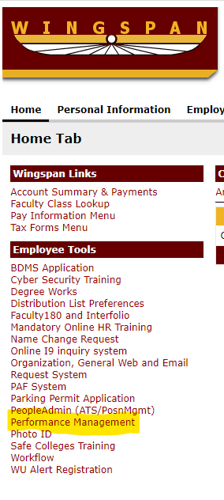
The Staff Evaluation Process in PeopleAdmin
Sign in to Wingspan
Select “Performance Management” under Employee Tools ( Screen Shot #1)
SCREENSHOT #1

Slide 5
The Staff Evaluation Process in PeopleAdmin
Step Two to Login:
You may or may not see this screen and have to provide your WU login credentials a second time (including Winthrop.edu):

Slide 6
The Staff Evaluation Process in PeopleAdmin
]
Step 3 to Login:
Next you will be taken to the Home Screen of People Admin
3a. On the User Group to the Right (just under your name) – click on the down button for the pulldown
3b. Select “Supervisor” as your User Group
3c. At the top left corner, right click on the three blue ellipse/periods
3d. Then select “Winthrop University Employee Portal”

Slide 7
The Staff Evaluation Process in PeopleAdmin

Slide 8
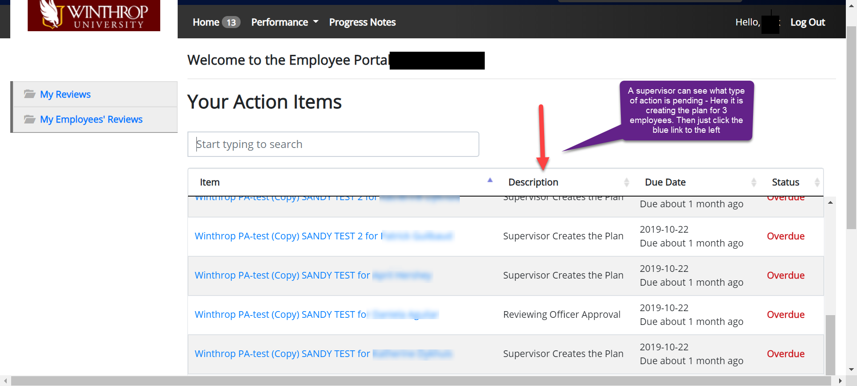
The Staff Evaluation Process in PeopleAdmin
This will take you to your personal launch page (see Screenshot #4 below) with your personal available action items shown.
Notes:
This screen shows your current action items. The employee's name is listed in the first column and the action to be performed is listed in the “description” column. For your own review you will tab on the left to “My Reviews” (only populated when your review is awaiting your input). You can go back to viewing the action items for the reviews of your direct reports by selecting the left tab “My Employees’ Reviews.”

Slide 9
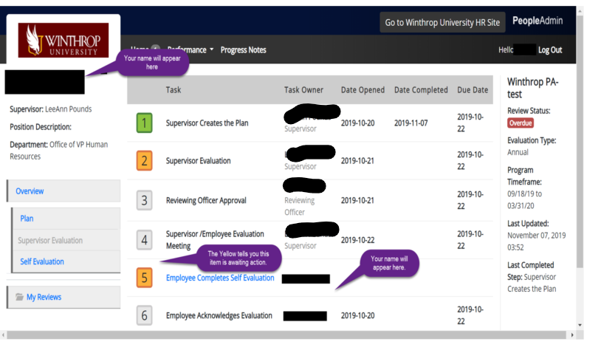
The Staff Evaluation Process in PeopleAdmin
Overview:

Slide 10
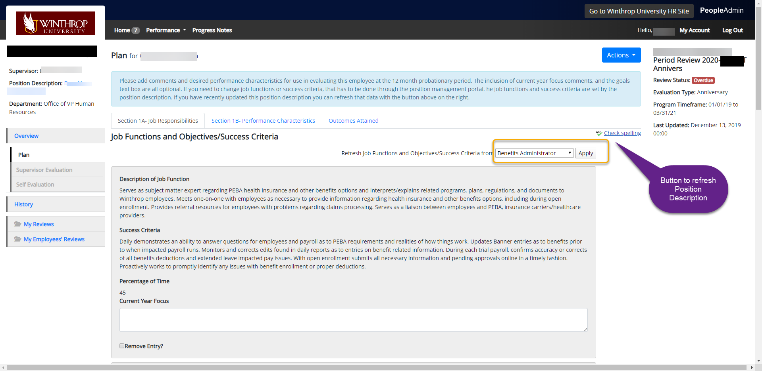
The Staff Evaluation Process in PeopleAdmin
Create a Plan (formerly called Planning Stage Document)
Notes:
No evaluation can be completed without a supervisor first creating a Plan (previously referred to as a “planning stage document”) inside People Admin.
For all types of reviews in the new system, a supervisor must start by selecting the blue link in the Item column for the employee where it lists the task of “Supervisor Creates the Plan.”
In most cases, when a supervisor opens the employee’s plan, they will find the following pre-populated:
the job functions, success criteria and the percentage of time dedicated for each job function
All this information is pulled in from the position description information (Position Management module) and pre-populated in a read-only format in the plan.
A Plan can be revised by the Supervisor, without HR involvement up to the time a self evaluation (optional) or supervisor evaluation is started. After that point, HRhelp@winthrop.edu or (803)323-2273 must be contacted to “unlock” the plan for the supervisor.
WHAT IF THERE IS NO JOB FUNCTIONS, SUCCESS CRITERIA OR PRECENTAGES PRE-POPULATED?
If the job functions, success criteria and percentage of time do not appear automatically in the plan, then you have to first submit a proposed position description, success criteria and percentages of time to HR for approval by using the “MODIFY POSITION DESCRIPTION” process – contact hrhelp@winthrop.edu or Scott Hoffmann at hoffmanns@winthrop.edu. If there is no position description information of any type, you must contact Scott Hoffmann at hoffmanns@winthrop.edu and develop a complete position description approved by HR, prior to the supervisor having any ability to create a planning document or performance review of the employee.
The creation of a plan involves:
Ia. Review of the job functions, success criteria and percentage of time allocated to function and confirm it accurately reflects the current job – If not, utilize the MODIFY POSITION DESCRIPTION process described
Ib. “Current Year Focus” is a new entry provided in the planning document to provide supervisors the option of adding any specific focus areas or instructions related to the upcoming year. This option has to be utilized as part of the planning document and cannot be revised or edited by the supervisor once the evaluation has been started, except by contacting HR and having the system to suspend the evaluation and any intermediary steps completed after the planning stage document. (During the evaluation process, any added “current year focus” will appear on the evaluation, but cannot be changed by the supervisor. There will still be a comment section on the evaluation form relating to each job function for a supervisor to add comments.)
Ic. Performance Characteristics [NOW REQUIRED AT PLAN STAGE]: The planning document offers the same type of drop down system that the prior system provided. The supervisor is to indicate (yes or no) as to whether the employee is a supervisor of other employees. If the employee being reviewed is a supervisor, there are two required performance characteristics to be selected for all supervisors that must be selected – diversity efforts and timely completion of performance reviews of subordinates. Otherwise, it is at the discretion of the supervisor what performance characteristic to select to review on as long as at least two performance characteristics is selected for every employee.
Id. Definition of Expectations [OPTIONAL]: is a new entry provided in the planning document to allow supervisors the option of adding specifics of their expectations for the upcoming months in relation to the performance characteristic selected for the planning document. This is recommended, but not required. At the time of the evaluation, any definition of expectations will appear on the form as read only, with an additional comment section under each performance characteristic for the supervisor to discuss the demonstration of that performance characteristic, or lack of demonstrating such a work demeanor in the past months.
Ie. Outcomes Attained/Goals Section [NEW and OPTIONAL]: The planning document now provides an optional entry for supervisors to add a “description of goals” to allow individual, department or division goals for an upcoming project or focus to be defined that are unique or part of a current strategic initiative and not reflected in the ongoing job functions and success criteria.
This “description of goals” has to be added at the time of creation of the planning document, and cannot be added at the time of completion of the evaluation. When a supervisor is completing the evaluation, they can address any goal added by providing information in a text box provided for “Goal status.”

Slide 11
The Staff Evaluation Process in PeopleAdmin
Staff Acknowledgment of the Plan
Employee must acknowledge the plan
Best practice to notify employee to log in (using same steps above, except User Group is “Employee”) and acknowledge
Next step either:
Notify employee to complete a self-evaluation by a date you select prior to your start of drafting the supervisor’s evaluation; or
Begin drafting supervisor’s evaluation.

Slide 12
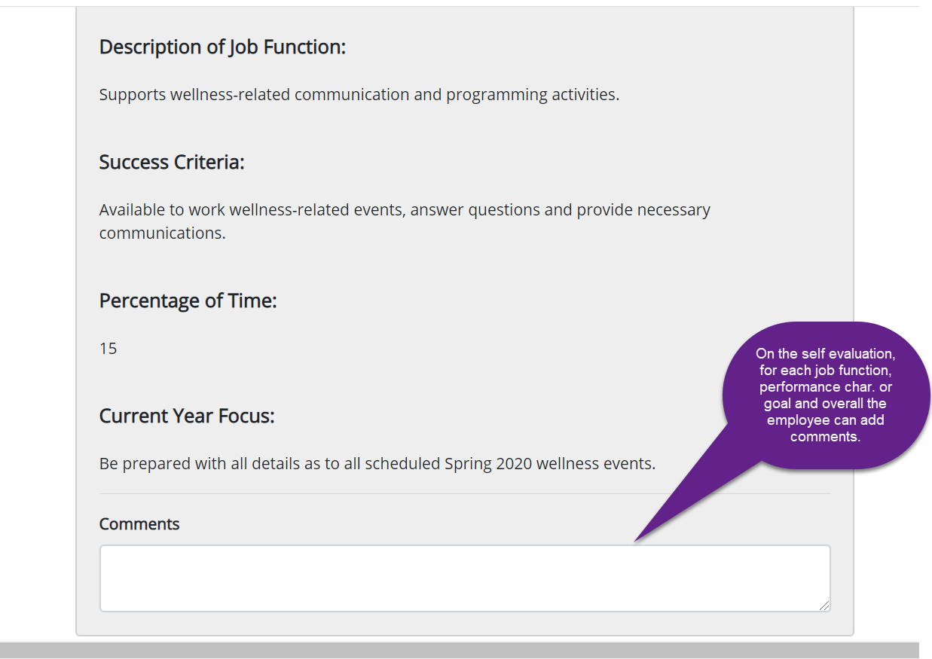
The Staff Evaluation Process in PeopleAdmin
Self-Evaluation Form – Optional at Supervisor’s Discretion

Slide 13
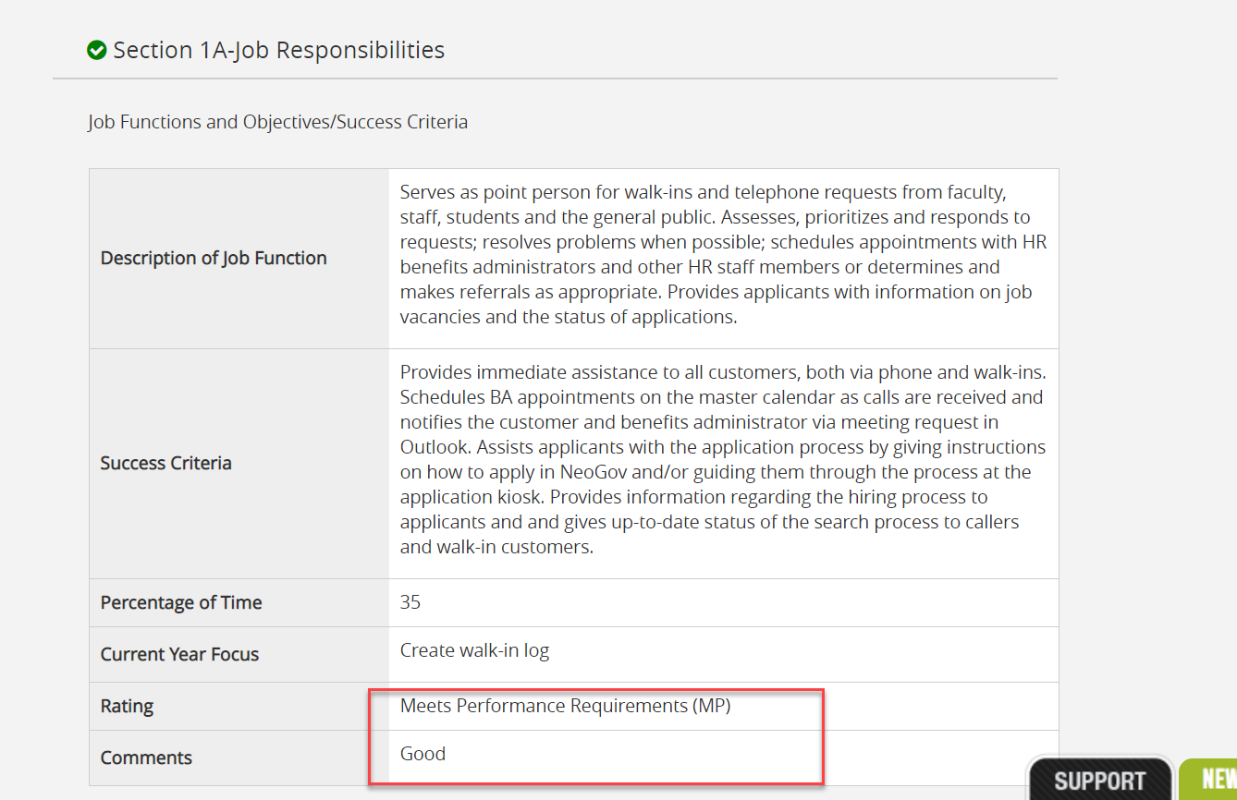
The Staff Evaluation Process in PeopleAdmin
Supervisor’s Evaluation – only fields to complete in Section 1A
Notes:
To complete a Supervisor Evaluation, log in as described on pages 1 and 2. In the Item column, click the link for the employee with a description of Supervisor Completes the Evaluation. Then scroll through the document (with information from the Plan pre-populated as Read Only ). There is a link entitled “EPMS Rating Guide” just below the tabs that provides a description of each of the 5 rating levels (unchanged from last year):
IIa. On the First Section Add a rating and comment (required) on each job function, including the 5% job function “perform other duties as assigned.” (N/A is an option for the “perform other duties as assigned” function if the employee was not required to engage in additional duties not described elsewhere this year.
IIb. In the Second Section add a rating on each Performance Characteristic. Comments are optional. No new Performance Characteristic can be added to the Evaluation, it must be included in the Plan.
IIc. In the Outcomes Attained section (Optional), if your plan listed a goal, add a progress rating under the Goal Status section (with options of Complete, In Progress, Not Completed and comment.
IId. In the Final section, add an overall rating and comment required.
IIe. Then click on the blue button at the end to “Save Draft” or “Complete” when ready to make the evaluation final.
All text boxes with a red asterisk are “required” to move forward. Any sections with a lock icon are read only and can only be modified with the assistance of HR.

Slide 14
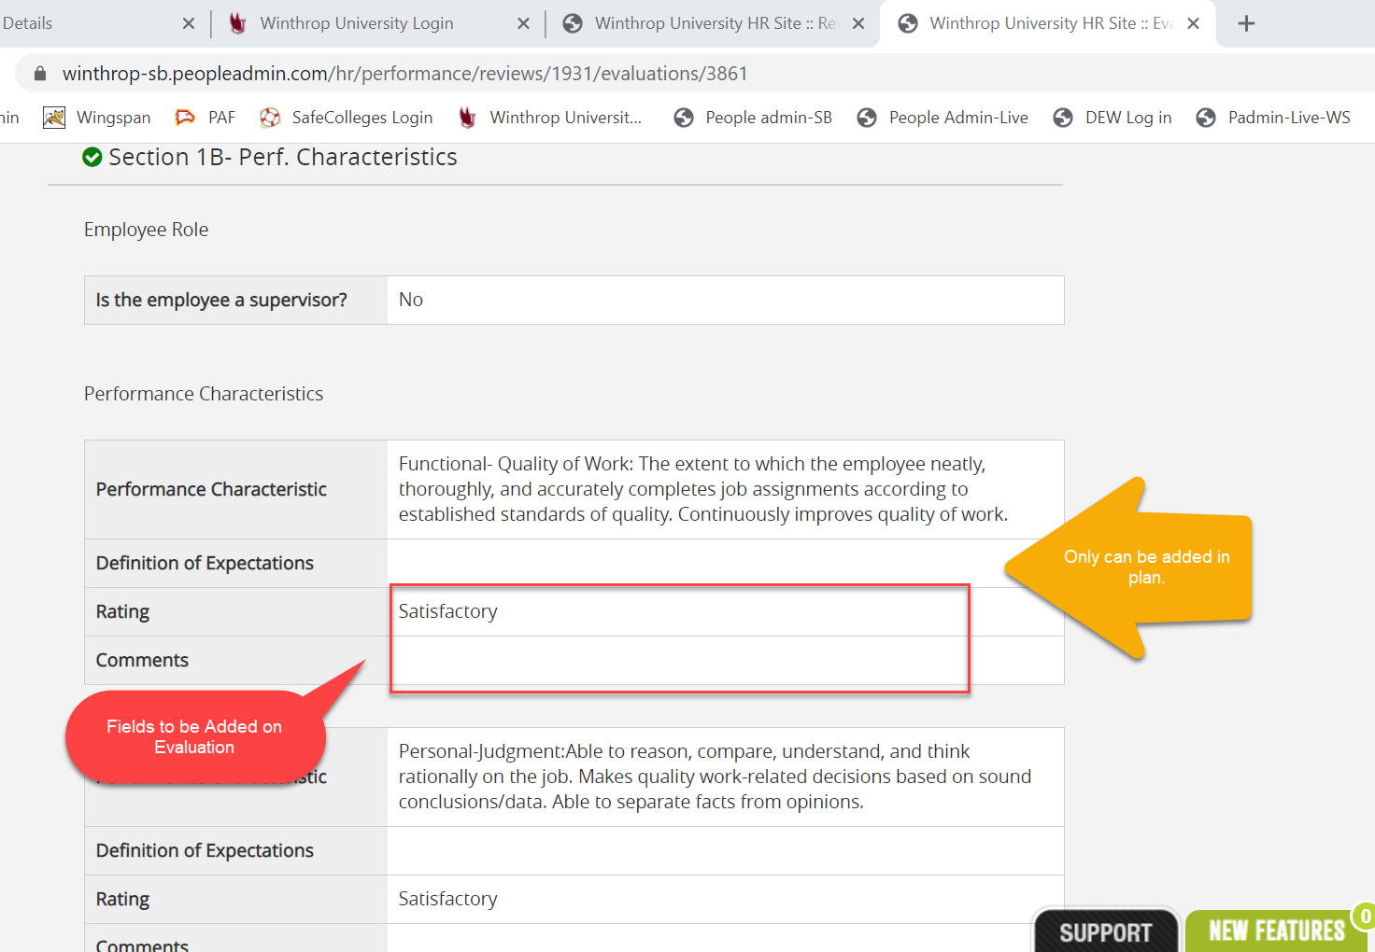
The Staff Evaluation Process in PeopleAdmin
Supervisor’s Evaluation – only fields to complete in Section 1B
Notes:
To complete a Supervisor Evaluation, log in as described on pages 1 and 2. In the Item column, click the link for the employee with a description of Supervisor Completes the Evaluation. Then scroll through the document (with information from the Plan pre-populated as Read Only ) to:
IIa. On the First Section Add a rating and comment (required) on each job function, including the 5% job function “perform other duties as assigned.” (N/A is an option for the “perform other duties as assigned” function if the employee was not required to engage in additional duties not described elsewhere this year.
IIb. In the Second Section add a rating on each Performance Characteristic. Comments are optional. No new Performance Characteristic can be added to the Evaluation, it must be included in the Plan.
IIc. In the Outcomes Attained section (Optional), if your plan listed a goal, add a progress rating under the Goal Status section (with options of Complete, In Progress, Not Completed and comment.
IId. In the Final section, add an overall rating and comment required.
IIe. Then click on the blue button at the end to “Save Draft” or “Complete” when ready to make the evaluation final.
All text boxes with a red asterisk are “required” to move forward. Any sections with a lock icon are read only and can only be modified with the assistance of HR.

Slide 15
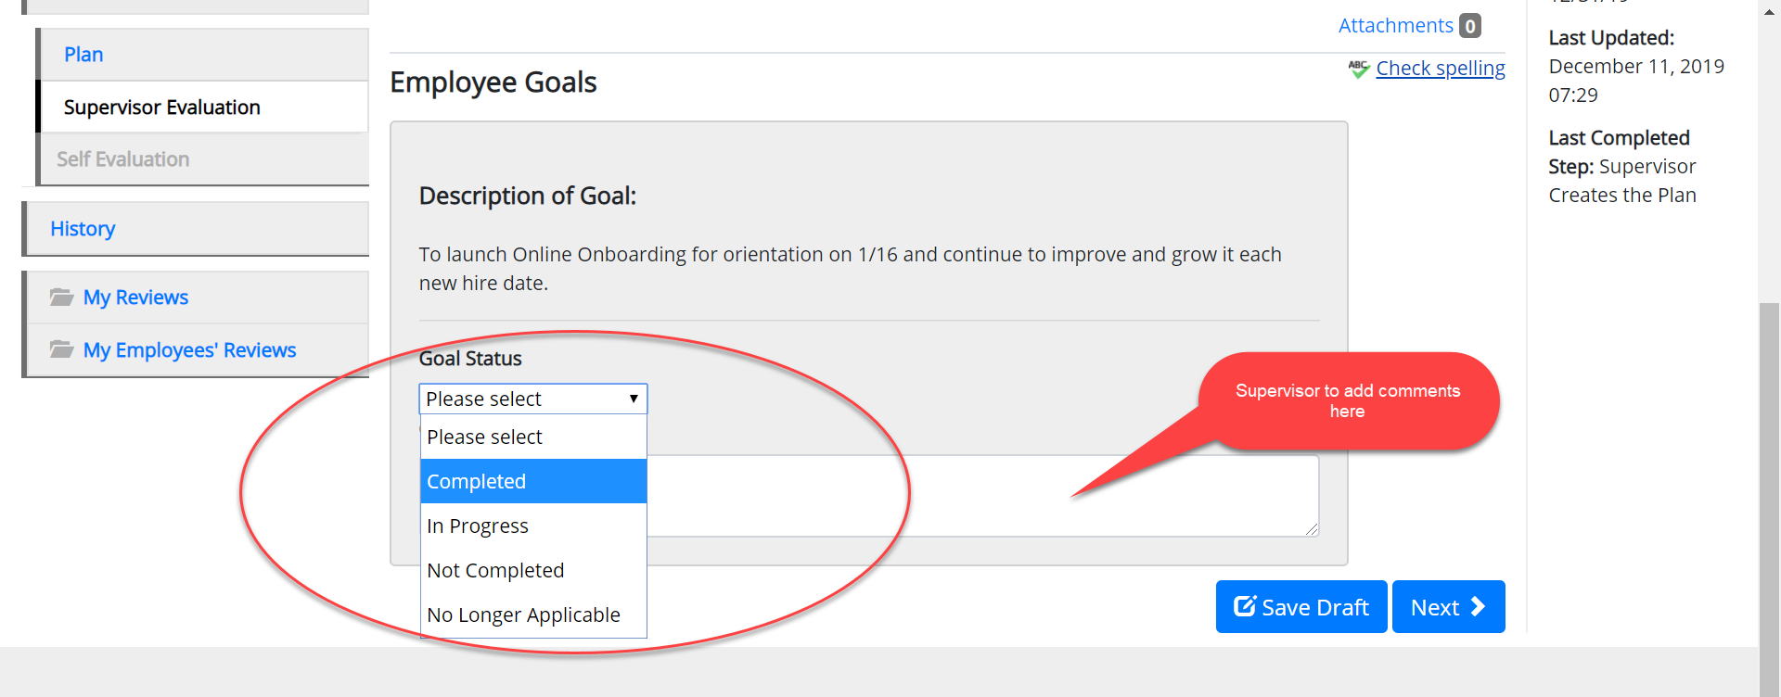
The Staff Evaluation Process in PeopleAdmin
Supervisor’s Evaluation – only Fields to complete in Section 1C
Notes:
To complete a Supervisor Evaluation, log in as described on pages 1 and 2. In the Item column, click the link for the employee with a description of Supervisor Completes the Evaluation. Then scroll through the document (with information from the Plan pre-populated as Read Only ) to:
IIa. On the First Section Add a rating and comment (required) on each job function, including the 5% job function “perform other duties as assigned.” (N/A is an option for the “perform other duties as assigned” function if the employee was not required to engage in additional duties not described elsewhere this year.
IIb. In the Second Section add a rating on each Performance Characteristic. Comments are optional. No new Performance Characteristic can be added to the Evaluation, it must be included in the Plan.
IIc. In the Outcomes Attained section (Optional), if your plan listed a goal, add a progress rating under the Goal Status section (with options of Complete, In Progress, Not Completed and comment.
IId. In the Final section, add an overall rating and comment required.
IIe. Then click on the blue button at the end to “Save Draft” or “Complete” when ready to make the evaluation final.
All text boxes with a red asterisk are “required” to move forward. Any sections with a lock icon are read only and can only be modified with the assistance of HR.

Slide 16
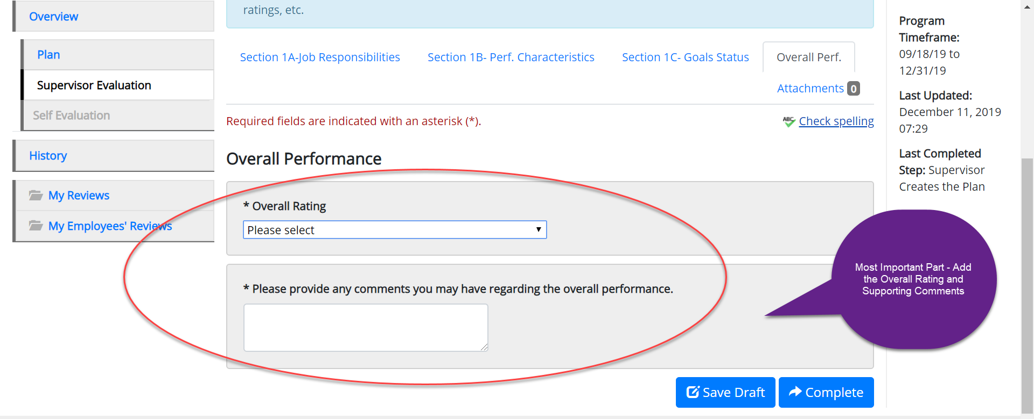
The Staff Evaluation Process in PeopleAdmin
Supervisor’s Evaluation – Overall Rating and Comments – VERY IMPORTANT
Notes:
To complete a Supervisor Evaluation, log in as described on pages 1 and 2. In the Item column, click the link for the employee with a description of Supervisor Completes the Evaluation. Then scroll through the document (with information from the Plan pre-populated as Read Only ) to:
IIa. On the First Section Add a rating and comment (required) on each job function, including the 5% job function “perform other duties as assigned.” (N/A is an option for the “perform other duties as assigned” function if the employee was not required to engage in additional duties not described elsewhere this year.
IIb. In the Second Section add a rating on each Performance Characteristic. Comments are optional. No new Performance Characteristic can be added to the Evaluation, it must be included in the Plan.
IIc. In the Outcomes Attained section (Optional), if your plan listed a goal, add a progress rating under the Goal Status section (with options of Complete, In Progress, Not Completed anand comment.
IId. In the Final section, add an overall rating and comment required.
IIe. Then click on the blue button at the end to “Save Draft” or “Complete” when ready to make the evaluation final.
All text boxes with a red asterisk are “required” to move forward. Any sections with a lock icon are read only and can only be modified with the assistance of HR.

Slide 17
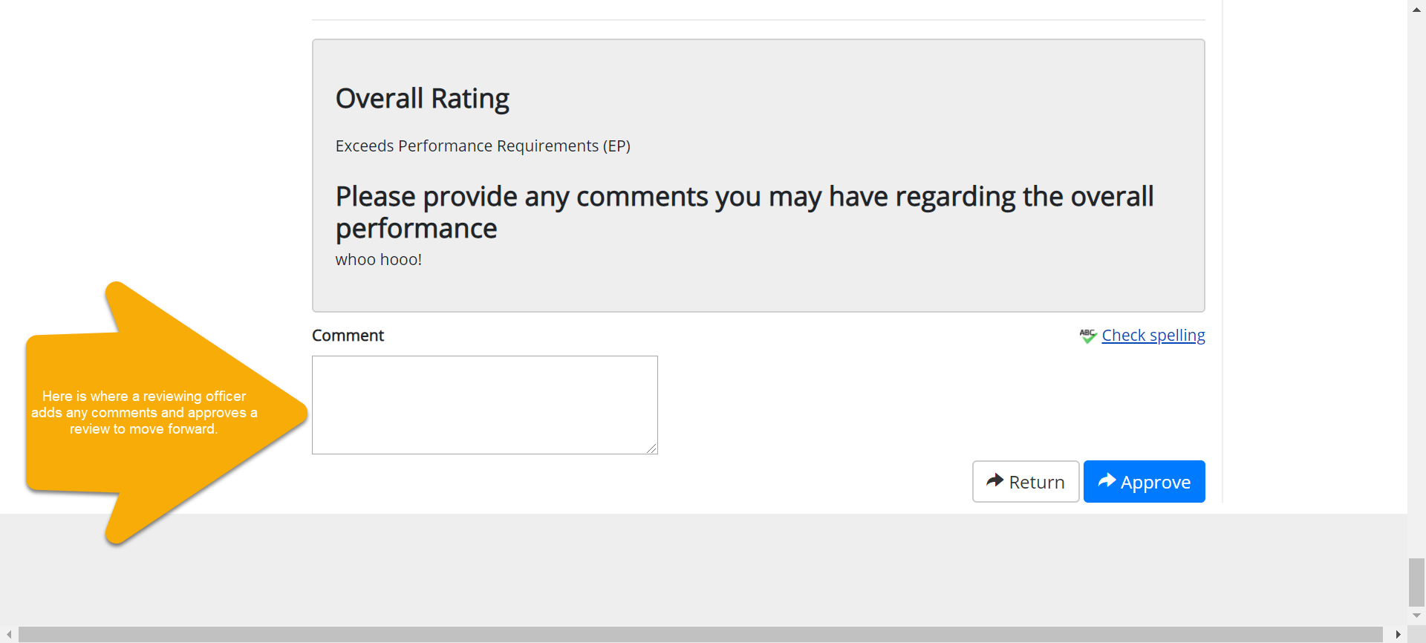
The Staff Evaluation Process in PeopleAdmin
Next Step: Submit Supervisor’s Evaluation to the Reviewing Officer
An Action Item should appear in the Reviewing Officer’s Personal Launch Page.
An automated email will be generated notifying the Reviewing Officer of the pending task (but can take a day to occur).
Reviewing Officer has option to:
Add comments (only visible to supervisor) and
Return to supervisor for edits or
Approve, which moves the process forward to the meeting step

Slide 18
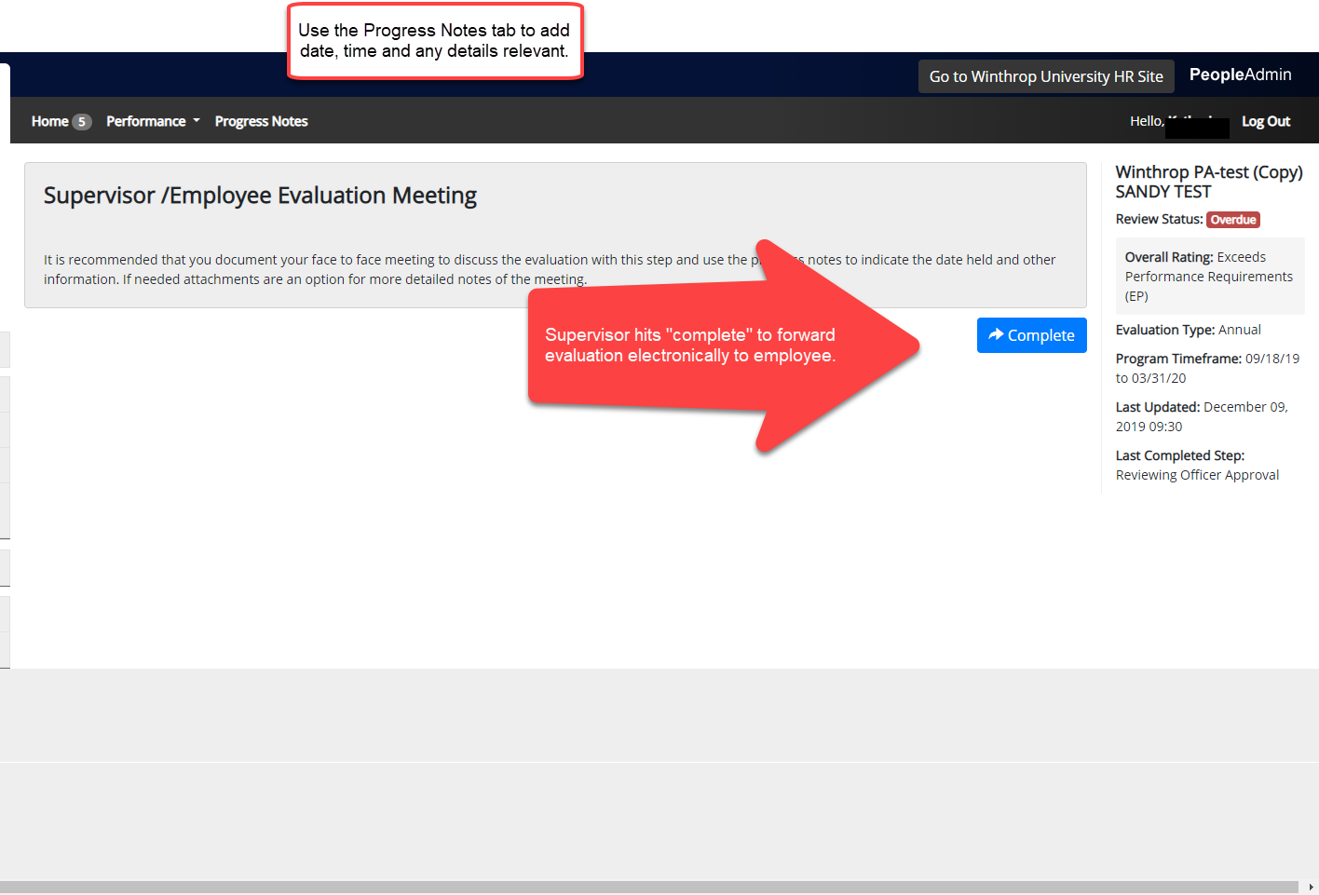
The Staff Evaluation Process in PeopleAdmin
Next step: Conduct Meeting and Confirm in System Meeting occurred.
Notes:
Employee cannot access evaluation yet in portal so supervisor has to make available in printed copy or save and email using “Print as PDF”

Slide 19
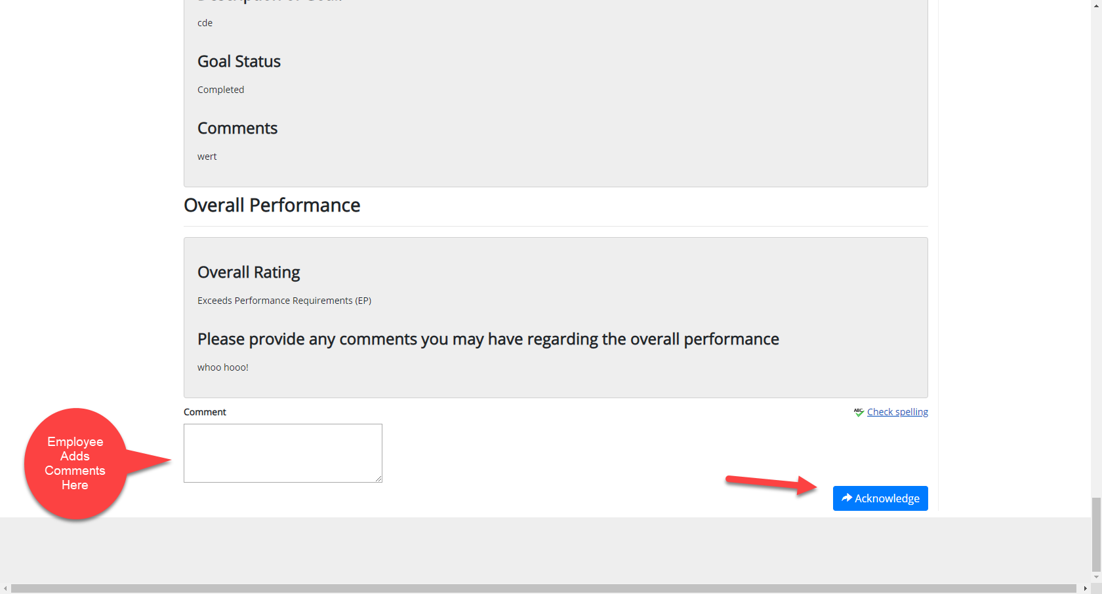
The Staff Evaluation Process in PeopleAdmin
Employee Acknowledges Supervisor’s Evaluation

